Slide 1
Chapter 9
Communication

Slide 2
“The most important thing in communication is to hear what isn’t being said.”
Peter Drucker

Slide 3
OBJECTIVES
Define the impact effective communication has in the workplace
Name the key elements of the communication process
Name the three types of communication media
Describe the dangers of becoming emotional at work
Demonstrate proper formatting for business letters and memos
Demonstrate basic telecommunication etiquette

Slide 4
WORKPLACE COMMUNICATION and its CHANNELS
Effective communication is vital to business
Improving communication skills is an ongoing process
Information is power
The goal is to over-communicate

Slide 5
WORKPLACE COMMUNICATION and its CHANNELS
Formal communication: communication that occurs through the formal lines of authority
Informal communication: communication that occurs among individuals without regard to the formal lines of authority
Regardless of which channel is used, you have an obligation to share
timely and relevant information
with the appropriate people

Slide 6
WORKPLACE COMMUNICATION and its CHANNELS
Formal Communication: Communication that occurs through formal lines of authority
Vertical communication—up or down the organization chart
Horizontal communication—occurring among individuals at the same or close organizational levels

Slide 7
WORKPLACE COMMUNICATION and its CHANNELS
Informal Communication: Communication that occurs among individuals without regard to the formal lines of authority
Grapevine
Not 100% accurate
Do not contribute negative information
Clarify inaccurate information/rumors
Do not make assumptions

Slide 8
WORKPLACE COMMUNICATION and its CHANNELS
Gossip: an informal communication network where personal and/or inappropriate information about individuals is shared
Gossip is hurtful and inappropriate
Gossip is a form of disrespect
Defend coworkers
Clarify misinformation

Slide 9
THE COMMUNICATION PROCESS
The process of a sender transmitting a message to an individual (receiver) with the purpose of creating mutual understanding

Slide 10
THE COMMUNICATION PROCESS
MESSAGE
Encoding
Decoding
SENDER
NOISE
RECEIVER
FEEDBACK
Figure 9-1

Slide 11
THE COMMUNICATION PROCESS
Sender: individual sending a message
Encoding: process of sender identifying how the message will be sent (verbal, non-verbal, or written)
Receiver: individual that receives the message
Decoding: how the receiver interprets the message that was sent
Feedback: the message the receiver sends based upon the receiver’s interpretation of the message
Noise: anything that interferes with the communication process (audible or not)

Slide 12
TALK IT OUT
Identify the noises you experience during class

Slide 13
THE COMMUNICATION PROCESS Communication Media
Verbal
Non-verbal
Written

Slide 14
VERBAL COMMUNICATION
Verbal Communication: the process of using words to send a message
Select the proper words
Stop and listen
Active listening-the receiver provides full attention without distraction
Passive listening-the receiver is selectively hearing parts of the message, focused more on his or her response
Non-listening-outside noises impede communication

Slide 15
TALK IT OUT
In what situations is it easy to be in “non-listening” mode? What can an individual do to improve his or her listening skills in such a situation?

Slide 16
NON-VERBAL COMMUNICATION
Non-verbal communication: what is communicated through body language
Eye contact
Facial expressions (smiles or frowns)
Nodding
Body positioning
Proxemics (space)

Slide 17
NON-VERBAL COMMUNICATION Emotions at Work
Make every attempt to not become emotional at work
Emotions take away our ability to think logically
If you become emotional or angry, excuse yourself and find a private place to compose
Open displays of anger are inappropriate

Slide 18
WRITTEN COMMUNICATION
Written Communication: a form of business communication that is either printed, handwritten, or sent electronically
Conveys aptitude and attitude
Receiver draws conclusions based upon grammar, vocabulary, presentation, and formatting used in written communication
Common forms include letters, memos, and electronic messages

Slide 19
WRITTEN COMMUNICATION
Professional, formal, and well-presented
Error-free
Clear message with carefully chosen words
With the exception of handwritten thank-you notes, written business communication should be keyboarded

Slide 20
WRITTEN COMMUNICATION
Plan your message
What you want to communicate
To whom you need to communicate
What is the desired action
Keep free from anger or negativity
If for a negative situation
Begin with a positive note and then factually address the situation
Keep correspondence short and simple

Slide 21
THE BUSINESS LETTER
Business letter: formal written form of communication used when message is being sent to an individual outside the organization
Use proper business format (may vary)
Sent on company letterhead or as an attachment with e-mail
Error-free
Proofread, sign, and date prior to mailing
Use company #10 mailing envelope

Slide 22
Most business letters will be on letterhead. Use a two-inch top margin before entering the current date. (Do not type QS and DS; these are shown for correct spacing.) The inside address includes the title and the first and last name of receiver. The salutation includes title and last name only. For the body, all lines begin at the left margin. Use a colon after the salutation and a comma after the complementary closing. Keep the closing simple. The writer’s first and last name should be four enters after the closing to give the writer room to sign (remember to have the writer sign). Typist’s initials Enclosure is used only if you add something to the envelope. | August 1, 2015 QS (4 enters or returns) Ms. Suzie Student Word Processing Fun 42 Learn Avenue Fresno, CA 93225 DS (2 enters or returns) Dear Ms. Student: DS The first paragraph of a letter should state the reason for the letter. If you had any previous contact with the receiver, mention it in this paragraph. DS The second (and possibly a third) paragraph should contain details. All information needing to be communicated is included here. DS The last paragraph is used to close the letter. Add information that is needed to clarify anything you said in the letter. Also, add any follow-up or contact information. DS Sincerely, QS Sarah S. Quirrel Sarah S. Quirrel Instructor DS bt Enclosure
Figure 9-2

Slide 23
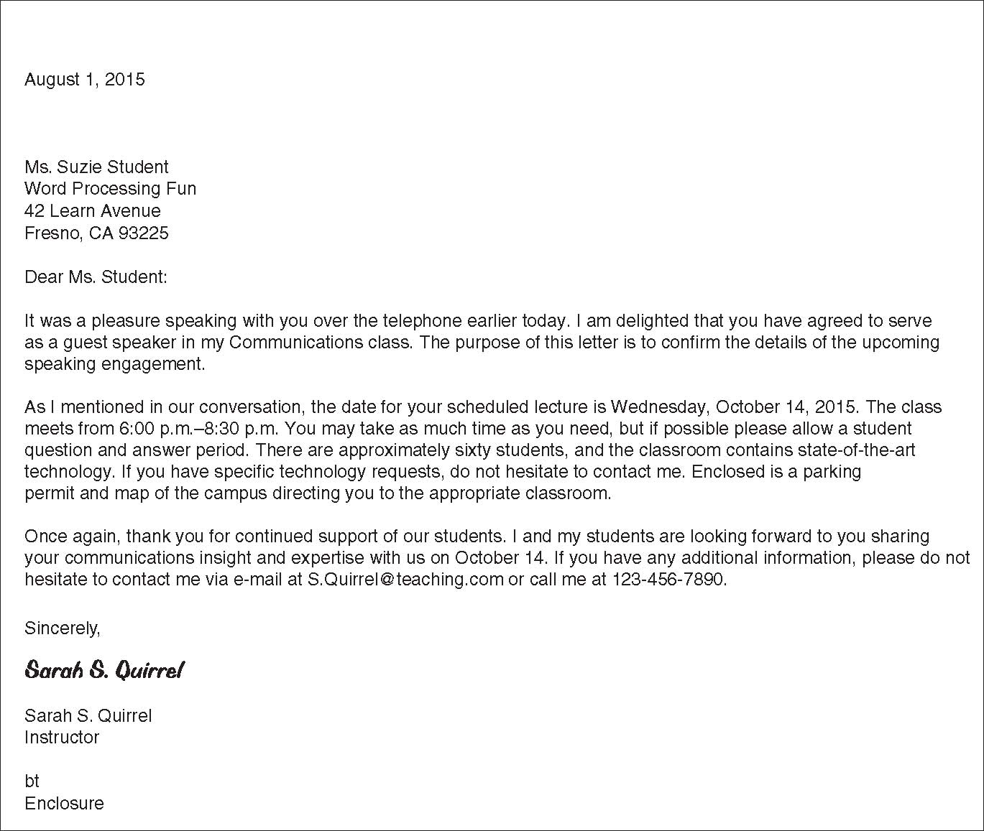
Figure 9-3

Slide 24
THE BUSINESS MEMO
Business Memo: a formal form of written business communication set to a receiver within an organization
Used for internal communication
Include receiver’s name, date, and subject
Include all facts, but be brief
Memos normally are no longer than one page

Slide 25
Start the memo two inches from the top of the page. Double space after each heading. Bold and capitalize only the headings, not the information. Use initial caps in the subject line. Body—single-space, no tabs, left align. Double-space between paragraphs. Reference initials (typist’s initials) Attachment notation, only if needed (if you are attaching something). | MEMO TO: Loretta Howerton, Office Manager FROM: Lawrence Schmidt, OA/CIS Consultant DATE: January 6, 2015 SUBJECT: Memo Format for Internal Correspondence A memorandum is an internal communication that is sent within the organization. It is often the means by which managers correspond with employees, and vice versa. Memos provide written records of announcements, requests for action, and policies and procedures. Use first and last names and include job titles. Templates, or preformatted forms, often are used for creating memos. Templates provide a uniform look for company correspondence and save the employee the time of having to design a memo. Word-processing software has memo templates that can be customized. Customize the template so it has the company name and your department name at the top. Make sure you change the date format (month, day, year). It should be as it is at the beginning of this memo. bt Attachment
Figure 9-4

Slide 26
Figure 9-5

Slide 27
THE THANK-YOU NOTE
Handwritten, in pen, on a note card
Just a few sentences
Sent when someone
does something kind that takes more than five minutes of their time, or
gives you a gift
Note should be delivered as soon as possible

Slide 28
Use the inside bottom of the note card. Include the date. Start your note with a salutation and the receiver’s name. Be brief but specific about why you are thanking the person. Include how you benefited from the person’s kindness. Do not begin every sentence with I. Use a complementary closing, and do not forget to sign your name. | June 3, 2015 Dear Mrs. McCombs, Thank you for loaning me your book on business etiquette. I especially liked the chapter on social events and dining. Your constant encouragement and mentoring mean so much to me. Sincerely, Mason Yang
Figure 9-6

Slide 29
THE THANK-YOU NOTE
TALK IT OUT
When is it appropriate to send a handwritten message? And, to whom?

Slide 30
DOCUMENTATION
Documentation: A formal record of events or activities
Employee evaluations
Client billing
Business operations
Workplace injury
Angry customer
Employee conflict

Slide 31
DOCUMENTATION
Describes the who, what, when, where, and why of a situation
Include date, time, and location of the event
Can be electronic, journal, company form, or notes on a calendar
Depending on situation:
Include who was present/witnesses
Note how people behaved or responded to the event
Documentation for personal reference when appropriate
Keep in confidential location

Slide 32
PRESENTATIONS
Both formal and informal presentations are a normal workplace event
Rich in media
Written, verbal, visual, non-verbal
Successful presentations:
Begin with a goal
Ensure each word, visual aid, activity, and handout supports the presentation goal

Slide 33
PRESENTATIONS
Three elements of formal presentations
Verbal content
Visual content
Support content
Verbal content
Do not directly read from visual
Speak clearly and slowly
Professional and appropriate language
Face audience
Beware of verbal and nonverbal nervous gestures

Slide 34
PRESENTATIONS
Visual Content: anything the audience will view or any activity the audience will perform during the presentation
Pre-test technology and equipment
Keep activity simple and non-distracting
Support Content: normally a handout
Reinforces verbal and visual message
Professional and visually appealing
Practice makes perfect!

Slide 35
SLANG and FOUL LANGUAGE
Slang: an informal language used among a particular group
Avoid using slang in the workplace – including verbal and written communications
It is not appropriate to use foul language
If you slip, immediately apologize

Slide 36
POTENTIALLY OFFENSIVE NAMES
Names that could be considered sexist and offensive are inappropriate in a business setting
Using inappropriate names toward coworkers will expose you and your company to a potential sexual harassment lawsuit

Slide 37
POTENTIALLY OFFENSIVE NAMES
Eliminate potentially offensive names from your workplace vocabulary
Instead of:
Postman
Policeman
Waitress
Stewardess
Maid
Use:
Postal carrier
Police officer
Server
Flight attendant
Housekeeper

Slide 38
NOT ALWAYS ABOUT YOU
There is one word that often dominates our vocabulary
When you are using verbal communication, think before you speak; if your initial sentence includes I, try to rephrase your message
Focus the conversation on others
The word is I

