Slide 1
Chapter 14
Resumé Package

Slide 2
“Whenever you are asked if you can do a job, tell ‘em, “Certainly I can!” Then get busy and find out how to do it.”
Theodore Roosevelt (1858-1919)

Slide 3
OBJECTIVES
Identify the steps for building a résumé package
Write a career objective or personal profile
Distinguish between a functional résumé
and a chronological résumé
Identify personal soft-skills, job-specific skills and transferable skills
Create a winning résumé
Write a cover letter

Slide 4
BUILDING YOUR RÉSUMÉ PACKAGE
Résumé package-cover letter and résumé
Résumé : a formal written profile that presents a person’s knowledge, skills, and abilities to potential employers
  Conflicting advice as to how the perfect résumé should look and what it should include
  Appropriate résumé depends on work experience
  A well written résumé makes it easy for potential employers to quickly identify your skills and work experience

Slide 5
BUILDING YOUR RÉSUMÉ PACKAGE
Five Steps toward a winning résumé:
  Career Objective/Personal Profile
  Gathering Information
  Proper Layout
  Skills, Accomplishments, and Experience
  The Final Résumé
As you construct your résumé, make every word, visual presentation, and information sell your skills and accomplishments

Slide 6
STEP ONE:
CAREER OBJECTIVE/PERSONAL PROFILE
Both statements are used on résumé to relate to target career, target employer, introduce key skills, and express interest in a position
Career Objective: used for individuals with little or no work experience
Personal Profile: used for individuals with more extensive career experience

Slide 7
STEP TWO:
GATHERING INFORMATION
Create draft document with the following key headings:
  Education
  Skills
  Employment
  Languages
  Honors and Awards
  Professional/Community Involvement
Do not include personal information

Slide 8
STEP THREE:
PROPER LAYOUT
Arrange information in proper résumé layout
Functional résumé layout:
  Emphasizes relevant skills and education
  Used for entry-level positions
  Typically one page
Chronological résumé layout:
  Emphasizes related work experience and skill sets
  Stresses major accomplishments and responsibilities
  Used for those with extensive career experience
  Typically two or more pages

Slide 9
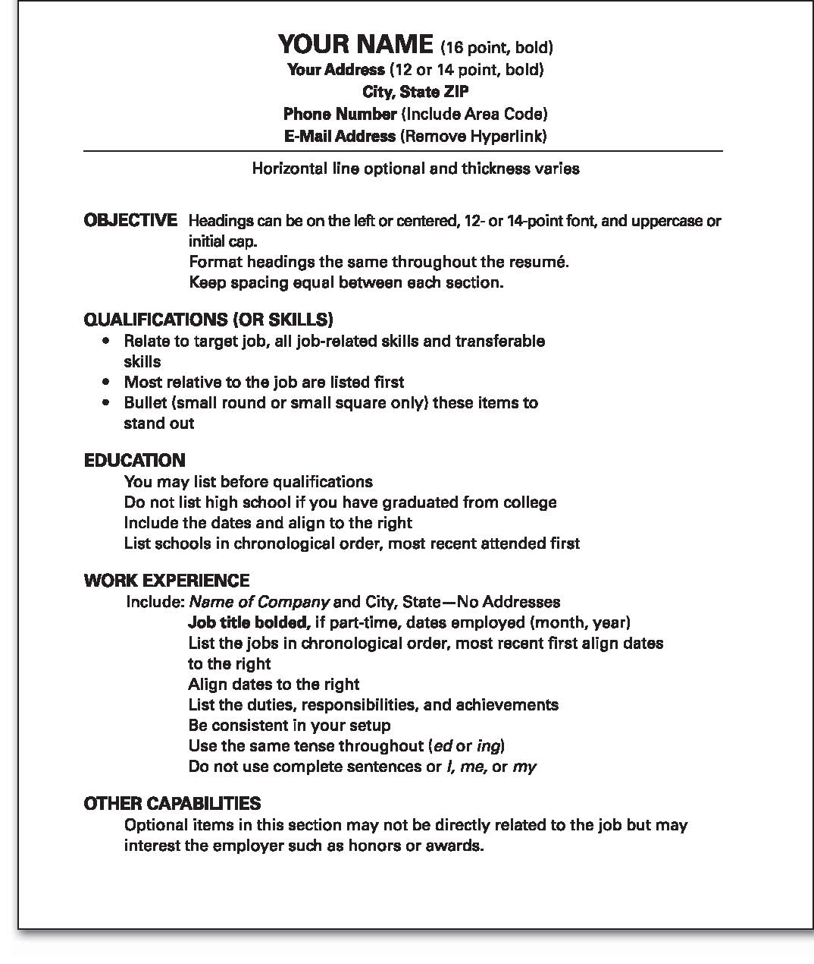
Figure 14-1

Slide 10
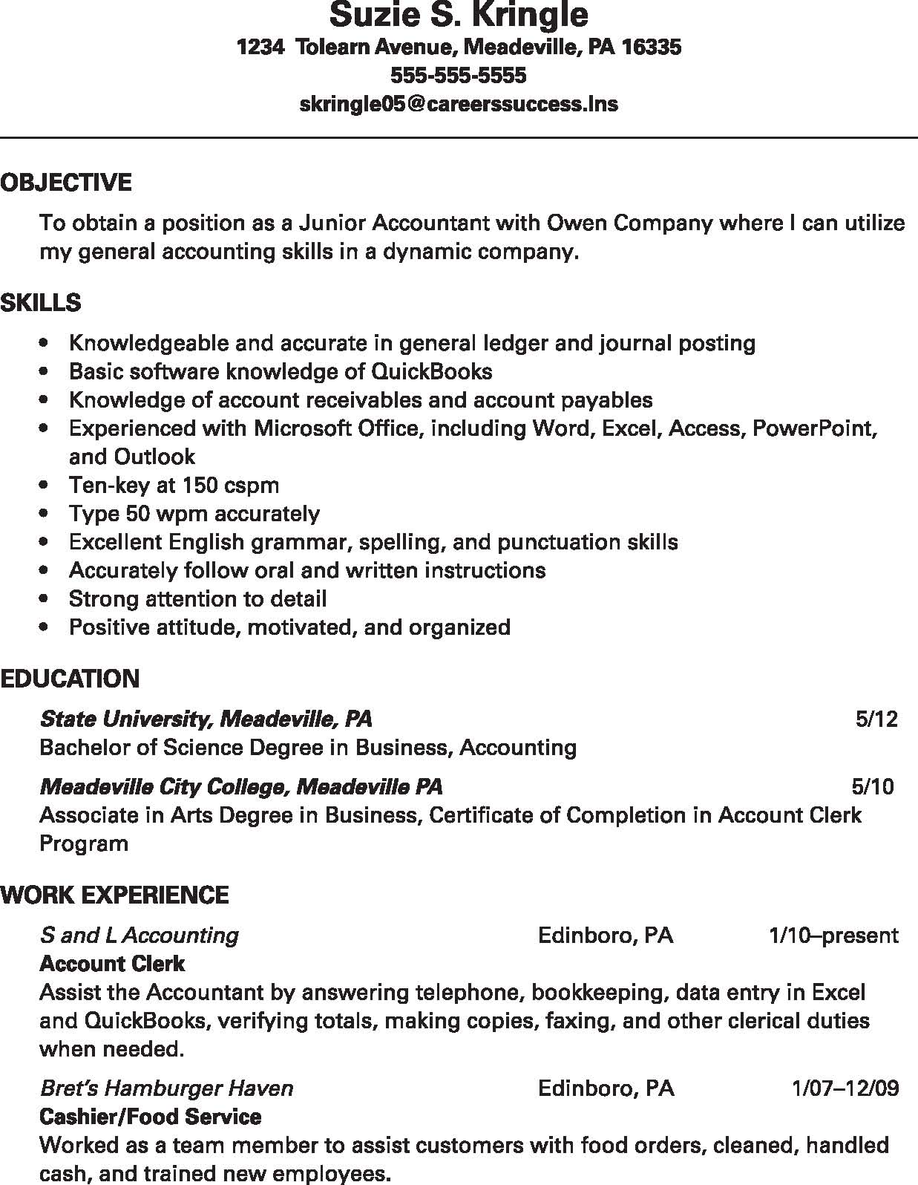
Figure 14-2

Slide 11
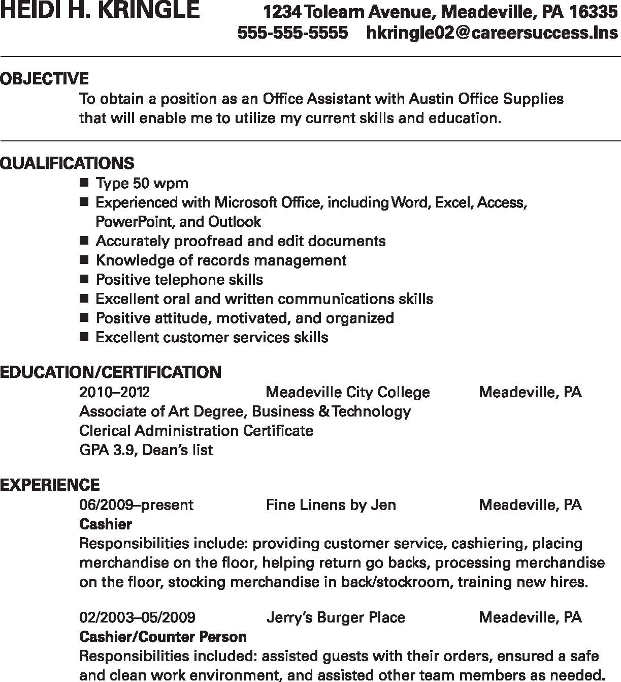
Figure 14-3

Slide 12
Figure 14-4

Slide 13
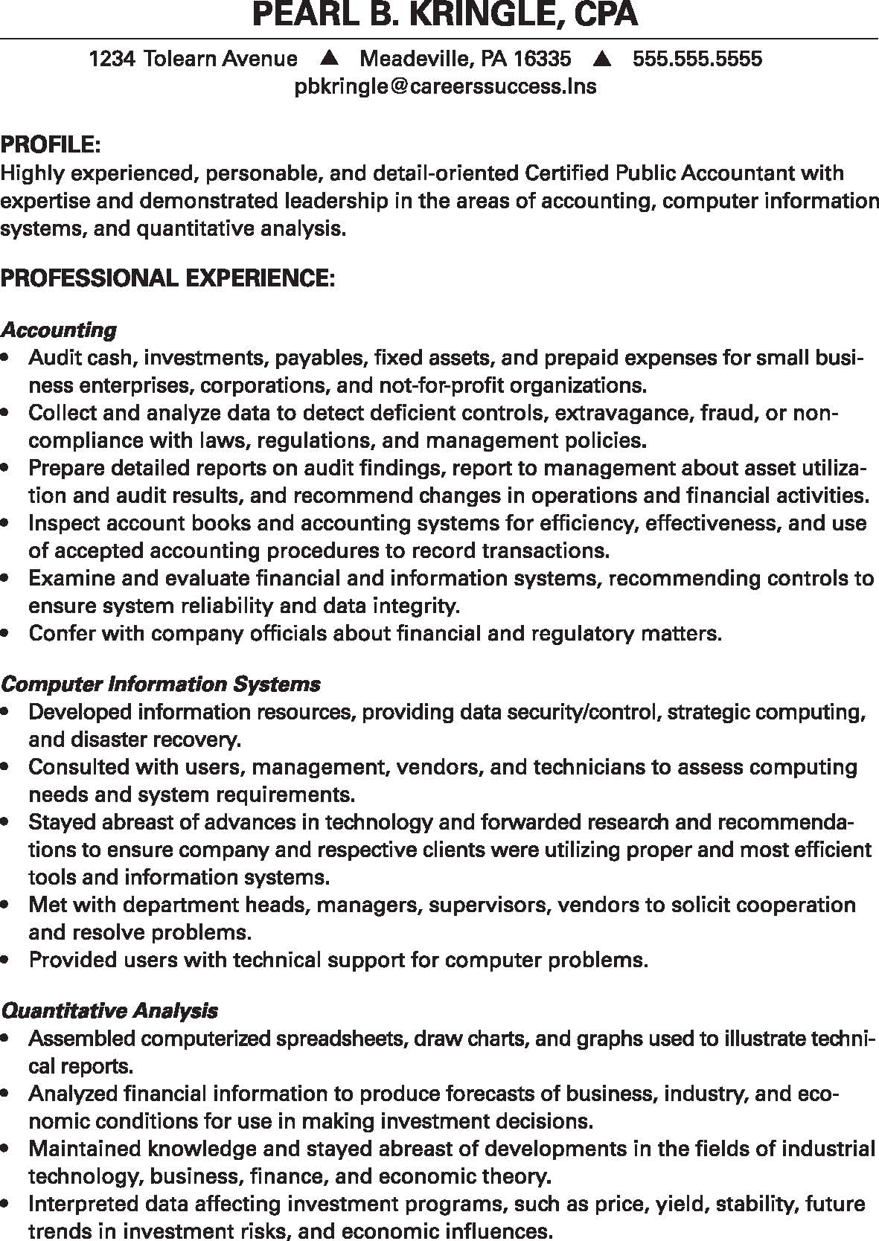
Figure 14-5

Slide 14
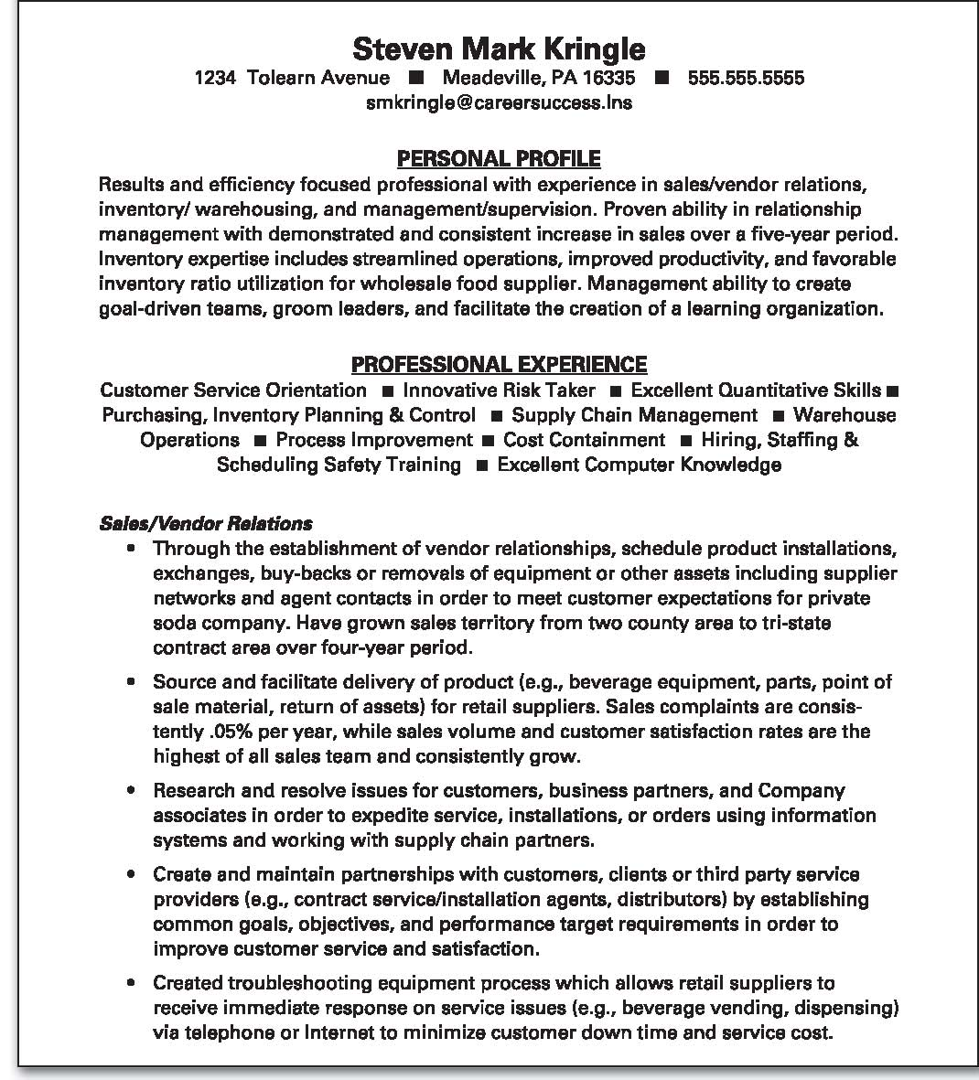
Figure 14-6

Slide 15
STEP THREE:
PROPER LAYOUT
Both résumé layouts present employment history and education in reverse time order
When listing work history, bold job title, not employer
When listing employment dates, use only month and year
Be consistent in layout, dates, and tense
Avoid the use of résumé templates

Slide 16
TALK IT OUT
Which résumé layout is best for your situation? Why?

Slide 17
STEP FOUR:
SKILLS, ACCOMPLISHMENTS & EXPERIENCE
Provide details in electronic document
  Limited or no experience (functional layout)
    Learned skills, job duties, and accomplishments
  Work and/or career experience (chronological layout)
    Specific activities achieved beyond job duties
Quantify skills, responsibilities, and accomplishments

Slide 18
STEP FOUR:
SKILLS, ACCOMPLISHMENTS & EXPERIENCE
Job-specific skills: skills that are directly related to a specific job or industry
  May not be useful in a career change
    Example: A Medical Billing Clerk who knows how to use a specific software program such as Medical Manager would not need to use this skill if he or she changed jobs to become a teacher

Slide 19
STEP FOUR:
SKILLS, ACCOMPLISHMENTS & EXPERIENCE
Transferable skills: skills that are transferred from one job to the next
  If you change careers, you will still be able to use (transfer) these skills
    Example: A Medical Billing Clerk may have consistent contact with patients and must practice patience and be positive when dealing with customers; if he or she becomes a teacher, that skill will be transferable to the children in the classroom

Slide 20
STEP FOUR:
SKILLS, ACCOMPLISHMENTS & EXPERIENCE
Soft skills: people skills necessary when working with others in the workplace
Employers want employees that are:
  Reliable
  Team players
  Good communicators
  Able to get along well with others

Slide 21
STEP FOUR:
SKILLS, ACCOMPLISHMENTS & EXPERIENCE
When listing work experience
  Include job title (bold)
  Company name
  City and state of company
  Duties of the position
When listing job duties
  Be as specific as possible
  First list skills most relevant to target job

Slide 22
STEP FOUR:
SKILLS, ACCOMPLISHMENTS & EXPERIENCE
Identify key knowledge, skills, and abilities the employer desires
  Secure a copy of the job description
  Use O’Net, a database of occupational information developed by U.S. Department of Labor
    Excellent resource to ID key requirements for specific jobs http://online.onetcenter.org/

Slide 23
STEP FOUR:
SKILLS, ACCOMPLISHMENTS & EXPERIENCE
Power Words: action verbs that describe accomplishments in a lively and specific way

Slide 24
STEP FOUR:
SKILLS, ACCOMPLISHMENTS & EXPERIENCE
Power words for skills section
Ideal oral and written communications skills
Understanding of office practices and procedures; ability to operate fax machine, copy machine, and ten-key machine; ability to enter data; ability to effectively interpret policies and procedures; work well under the pressure of deadlines; establish and maintain a positive working relationship with others; ability to communicate
Accurate typing skills at ______ wpm
Experienced with Microsoft Office, including Word, Excel, Access, PowerPoint, and Outlook

Slide 25
STEP FOUR:
SKILLS, ACCOMPLISHMENTS & EXPERIENCE
Power words for skills section cont.
Excellent English grammar, spelling, and punctuation skills
Accurately proofread and edit documents
Strong attention to detail
Accurately follow oral and written instructions
Excellent attendance and punctual record
Maintain confidentiality
Positive attitude, motivated, and organized

Slide 26
STEP FOUR:
SKILLS, ACCOMPLISHMENTS & EXPERIENCE
Power words for work section
Prepared reports and other materials requiring independent achievement
Enjoy working in a flexible team situation
Established and maintained positive and effective working relationships
Planned, scheduled, and performed a variety of clerical work
Maintained office equipment and supplies
Proofread forms and materials for completeness and accuracy, according to regulations and procedures

Slide 27
STEP FOUR:
SKILLS, ACCOMPLISHMENTS & EXPERIENCE
Power words for work section cont.
Processed and prepared materials for pamphlets, bulletins, brochures, announcements, handbooks, forms, and curriculum materials
Provided training of temporary or new employees
Maintained department files and records
Demonstrated ability to receive incoming calls and route them efficiently
Experience power phrases
Processed purchase requisitions, ordered and distributed supplies, and maintained inventory control
Responsibly planned and conducted meetings

Slide 28
STEP FIVE:
COMPLETE THE RÉSUMÉ
Information Heading: personal contact information including:
  Name (complete and formal – including middle initial)
  Mailing address (check for accuracy)
  City, state & zip code (check format, capitalization and punctuation)
  Contact phone (only one phone number)
  E-mail address (remove hyperlink, professional address)

Slide 29
STEP FIVE:
COMPLETE THE RÉSUMÉ
Review Career Objective or Personal profile
  Ensure it introduces reader to who you are
  Encourage reader to learn about your specific knowledge, skills, abilities, and key accomplishments
Review appropriate and proper résumé layout
  Confirm sub headings
  Consistent setup, tense
  Check spelling and grammar

Slide 30
STEP FIVE:
COMPLETE THE RÉSUMÉ
Completion tips
  List experience and education chronologically (most recent first)
  Keep setup consistent (all periods or none, line spacing, alignment, format, uppercase/lowercase words)
  Be consistent with word endings (keep the tense the same in each section)

Slide 31
STEP FIVE:
COMPLETE THE RÉSUMÉ
Underline, bold & italicize for emphasis only
Only use bullets to emphasize key skills
Use easy to read font and size
  Times New Roman or Arial
  12-14 point
Only use black ink
Do not include personal information
  No photos, birth date, marital status, SSN or hobbies
Do not list “References Available” on résumé

Slide 32
STEP FIVE:
COMPLETE THE RÉSUMÉ
Professional presentation
Printed on black ink (laser print ideal)
8½ x 11 inch, letter-sized paper
Cotton fiber, 24 pound white paper (not bound)
Single sided - if more than one page, place name at top of each page
Do not staple documents

Slide 33
STEP FIVE:
COMPLETE THE RÉSUMÉ
Check for information that is frequently forgotten or not presented appropriately

Slide 34
STEP FIVE:
COMPLETE THE RÉSUMÉ
When you think it’s perfect …
  Have several individuals review for
    Clarity
    Consistency
    Punctuation
    Grammar
    Typographical errors
    Other potential mistakes

Slide 35
SHARING YOUR RÉSUMÉ
Start with a perfect résumé
Online version
  Consider content-use keywords
  Send as an attachment to preserve formatting
    MS Word
    Portable document file (pdf)
  Electronic job boards
  Guard personal information

Slide 36
SHARING YOUR RÉSUMÉ
Electronic file
  Microsoft Word vs. portable document file (.pdf)
Electronic formatted résumé:
  American Standard Code for Information Interchange (ASCII)
  Used when employers add résumé to special software to search applicants based on key words
  Special format
  Key words
  Times New Roman (10-14 point)

Slide 37
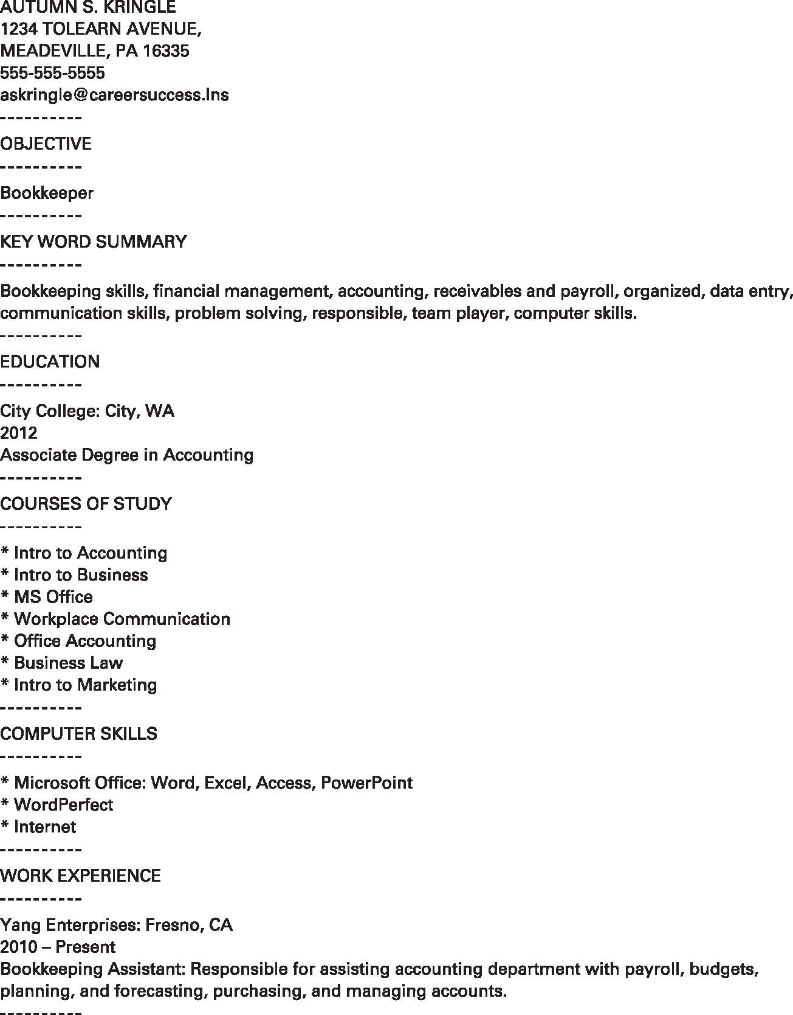
Figure 14-7

Slide 38
COVER LETTERS
Cover letter: formal letter used as an introduction to a résumé
First impression for potential employers
Use a friendly but professional tone
Point out how you can meet the employer’s needs
Do not duplicate resumé; instead, expand the areas of interest to target employer

Slide 39
COVER LETTERS
Although it is acceptable to utilize “I” and “my” in a cover letter, be careful not to begin most sentences with the word “I”
Address cover letter to specific person
Refer reader to the resumé
Request interview (not job) at close of letter
Display initiative

Slide 40
COVER LETTERS
Carefully review job announcement
Identify key job skills, and highlight company needs
Include key qualifications in both cover letter and résumé
In the cover letter:
  Mention the target company by name
  Mention how you learned of the job
  List specific qualifications (reflected from the job posting) that make you an excellent candidate to interview
Include daytime telephone number on both
  Telephone voice mail and/or message machine is professional
  Do not include introductions that are unprofessional

Slide 41
COVER LETTERS
Be honest with potential employer
List jobs held while incarcerated (correctional facility in place of employer)
List all education received while incarcerated (include educational institution that provided training)
Do not lie on employment application
  Check “yes”
  Write “will explain during interview”

Slide 42
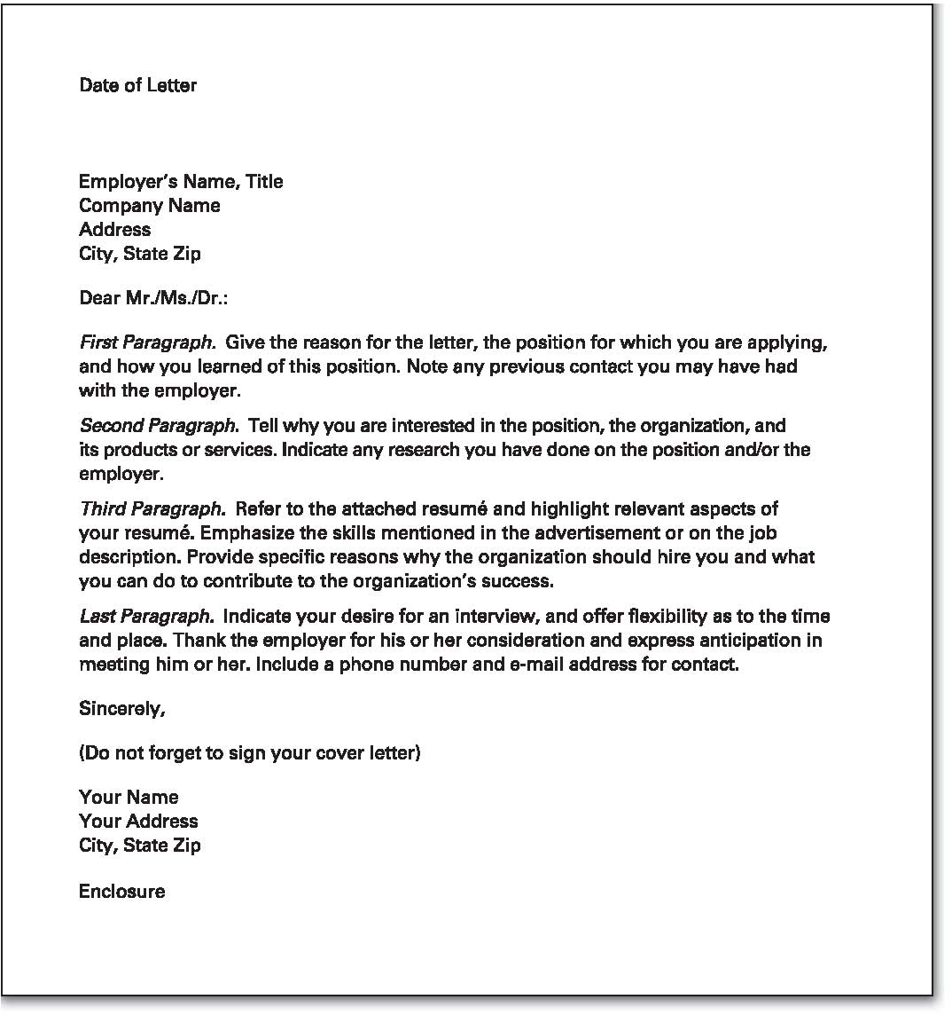
Figure 14-8

Slide 43
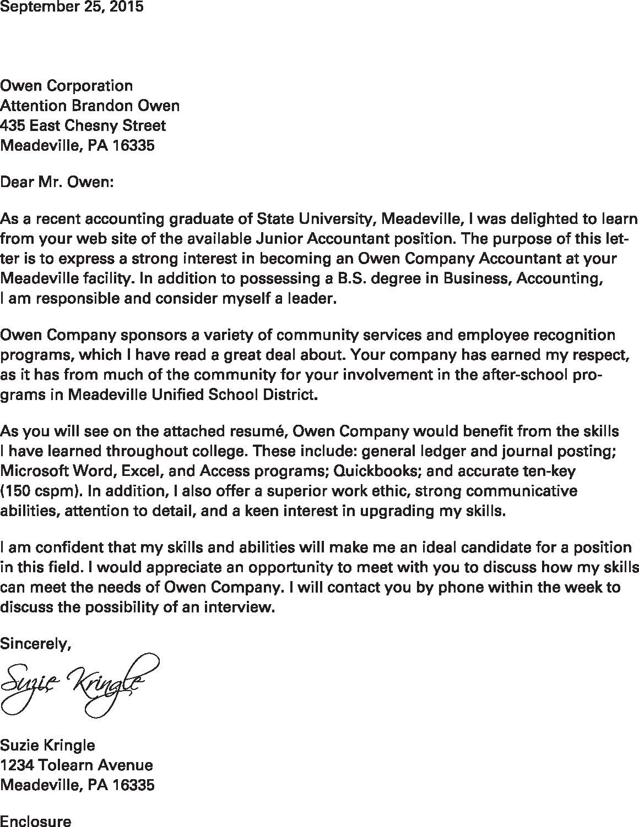
Figure 14-9

Slide 44
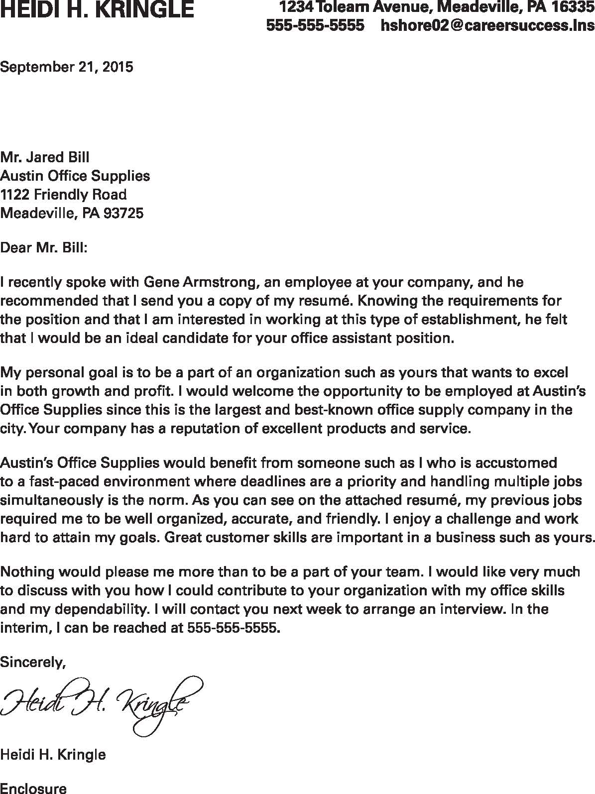
Figure 14-10

Slide 45
TAILORING YOUR RESUMÉ
AND COVER LETTER
Identify key skills for your targeted position
List key skills first on the resumé
Emphasize specific qualification in the cover letter
List phone and e-mail address on resumé
and cover letter
Make phone message professional

Slide 46
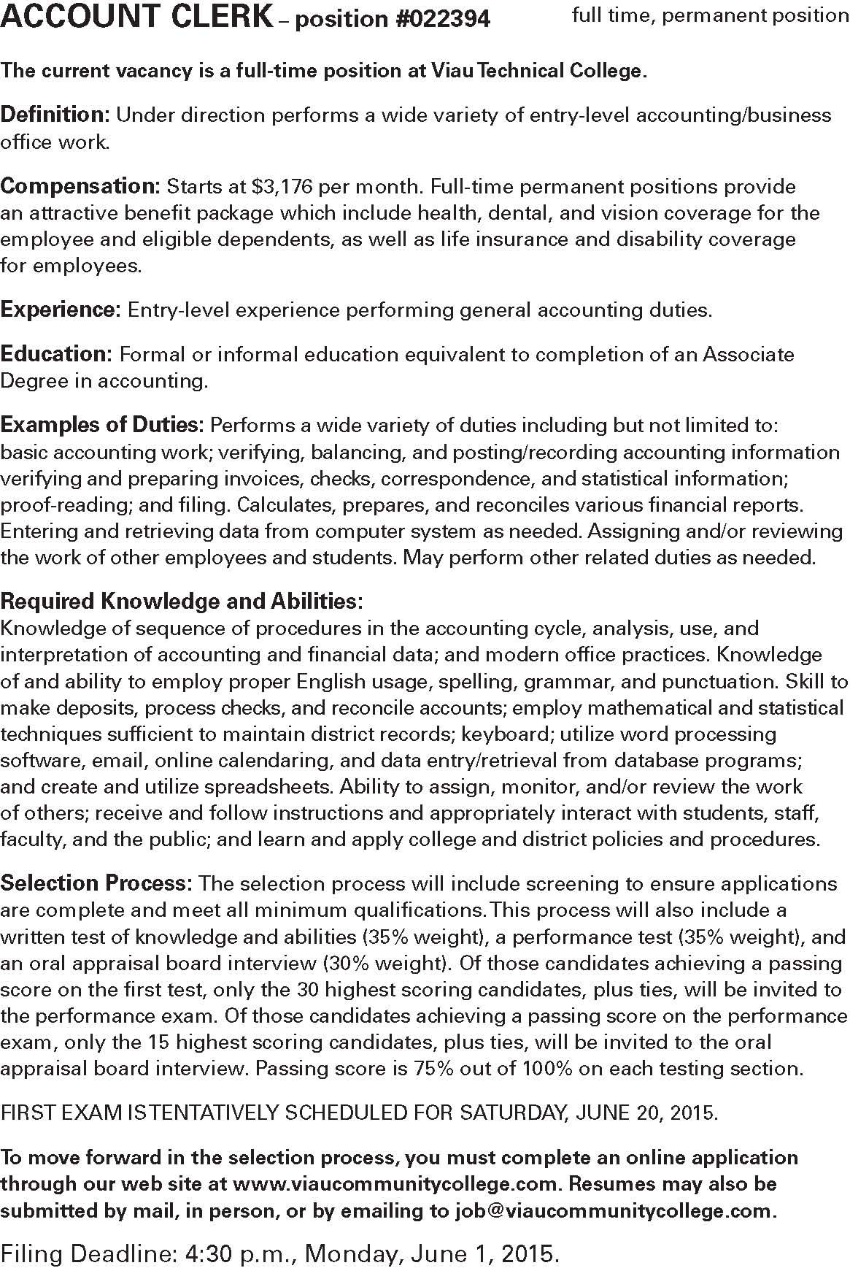
Figure 14-11

